Slide 1
Know Your Faith IV: The Church Fathers
Session 1: The Apostolic and
Ante-Nicene Fathers
Their place in Christian History,
The world to which they witnessed,
Their writings.
Ignatius of Antioch, Clement of Rome, Polycarp of Smyrna

Slide 3
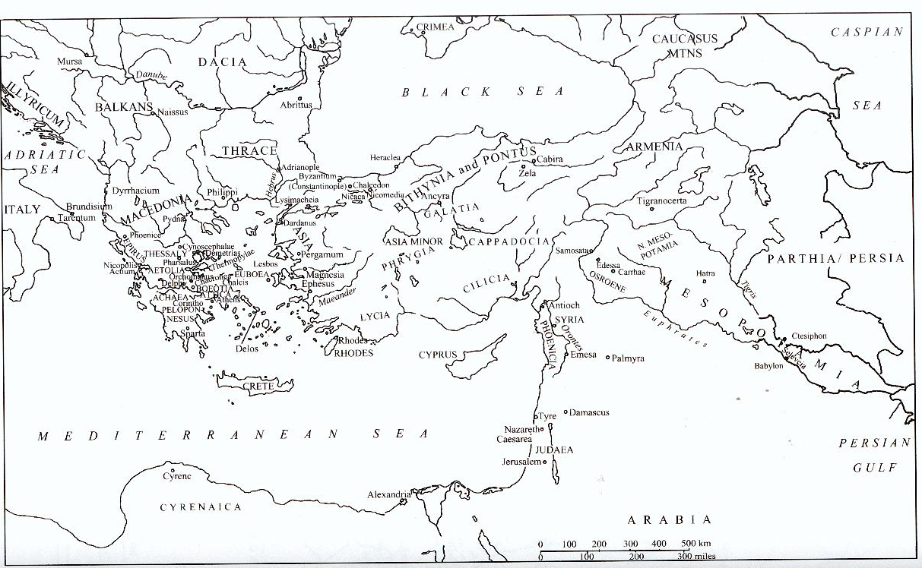

Slide 4
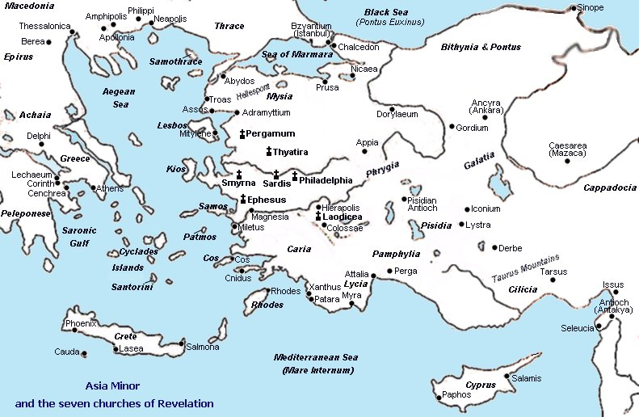

Slide 5
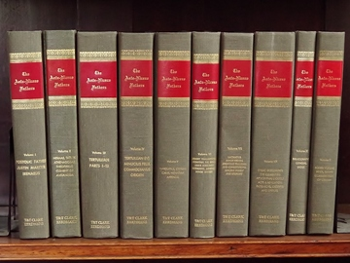
The Writings of the Apostolic and Ante-Nicene Fathers
The Epistle to Diognetus
The First Epistle of Clement
The Second Epistle of Clement
The Didache
The Epistle of Barnabas
7 short Epistles of Ignatius of Antioch (the longer forms of these Epistles, and those beyond the seven, are widely considered later emendations and forgeries)
The Epistle of Polycarp
The Martyrdom of Polycarp
The Shepherd of Hermas
The ANF, a Most Valuable Resource

Slide 6
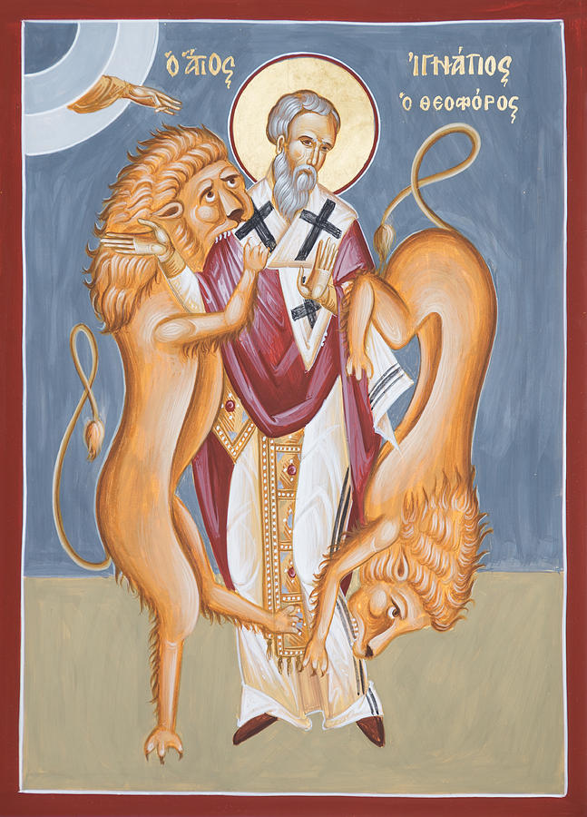
Ignatius of Antioch
Letters of Ignatius of Antioch
To the Ephesians
To the Magnesians
To the Philadelphians
To the Romans
To the Smyrnaeans
To the Trallians
To Polycarp
The Martyrdom of Ignatius

Slide 7
St Clement of Rome

Slide 8
St Polycarp of Smyrna
Only extant writing:
Epistle to the Phillippians
"Stand fast, therefore, in this conduct and follow the example of the Lord, 'firm and unchangeable in faith, lovers of the brotherhood, loving each other, united in truth,' helping each other with the mildness of the Lord, despising no man."

Slide 9
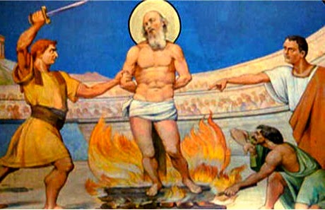
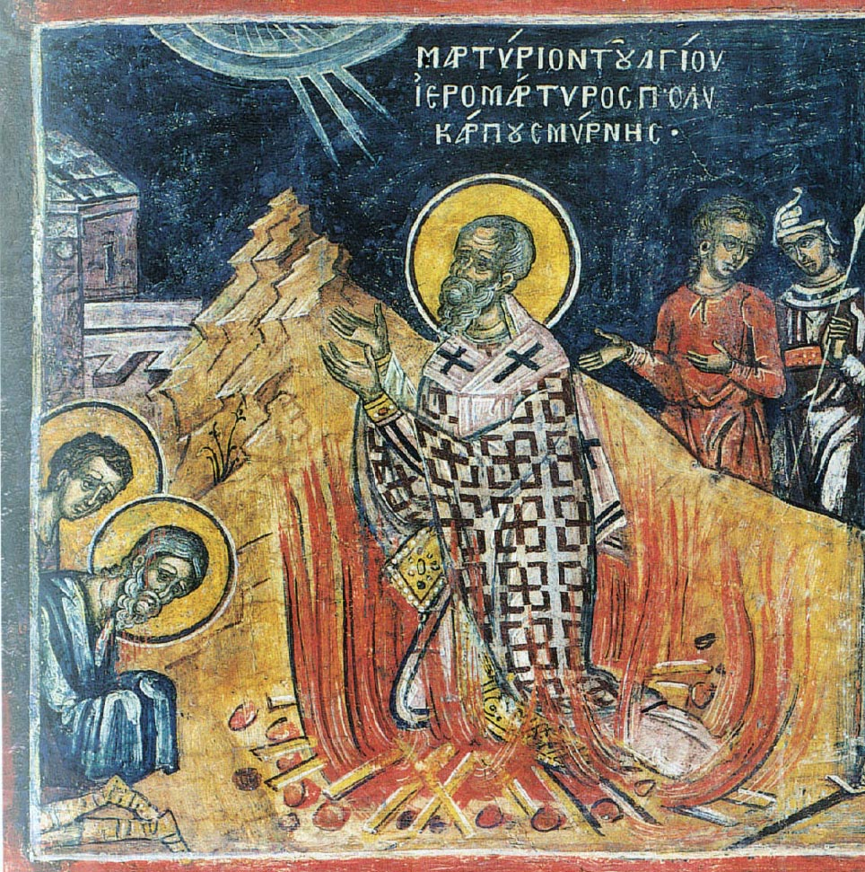
The Martyrdom of Polycarp
Witnessing to the Christian faith of the resurrection and embracing the will of God.

