Slide 1
Know Your Faith IV: The Fathers of the Church
Lesson 16
The Later Fathers:
St Nicholas Cabasilas

Slide 2
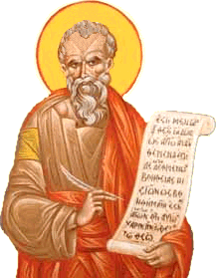
St Nicholas Cabasilas
c 1322 - after 1387
Palamite
Mystic Theologian
Monastic
Liturgist

Slide 3
Patronized by John VI Kantakouzenous
Later known as of Joasaph Christodoulos

Slide 4
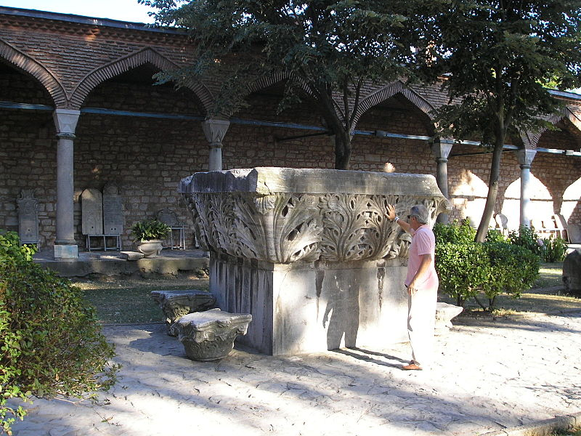
Remains of the Manganon Monastery near Constantinople

Slide 5
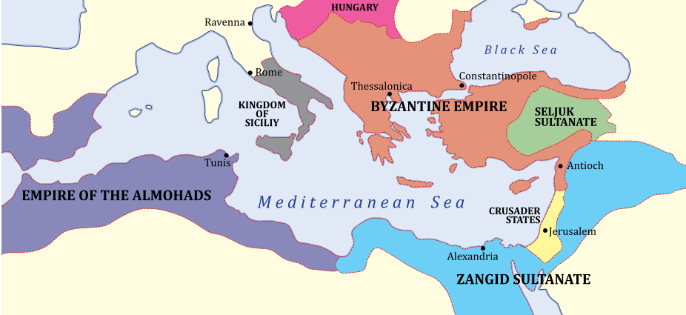
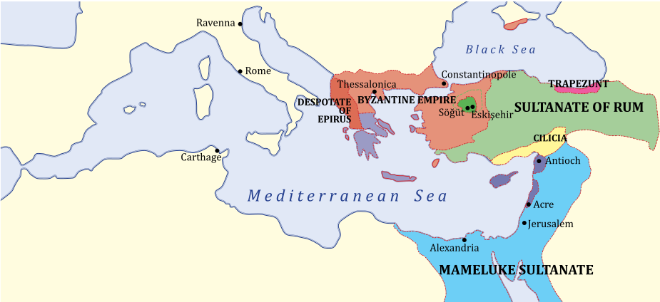
The Byzantine Empire in 1180 and 1263

Slide 6
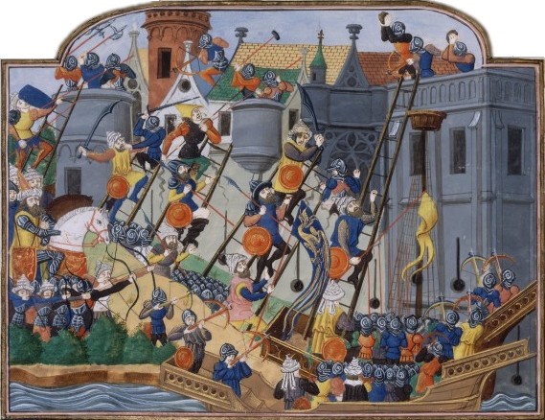
The World of
St Nicholas Cabasilas
1054: The Great Schism: The Latin Roman Church and the Greek Orthodox Church excommunicate each other.
1202: Fourth Crusade is assembled at Venice.
1204: Fourth Crusade captures Constantinople. The Latin Empire of Constantinople is formed as well as many Byzantine successor states. The capture of Constantinople in 1204 was a blow from which the Byzantines never fully recovered.
1453: Fall of Constantinople to the Ottomans. End of the Byzantine Empire.

Slide 7
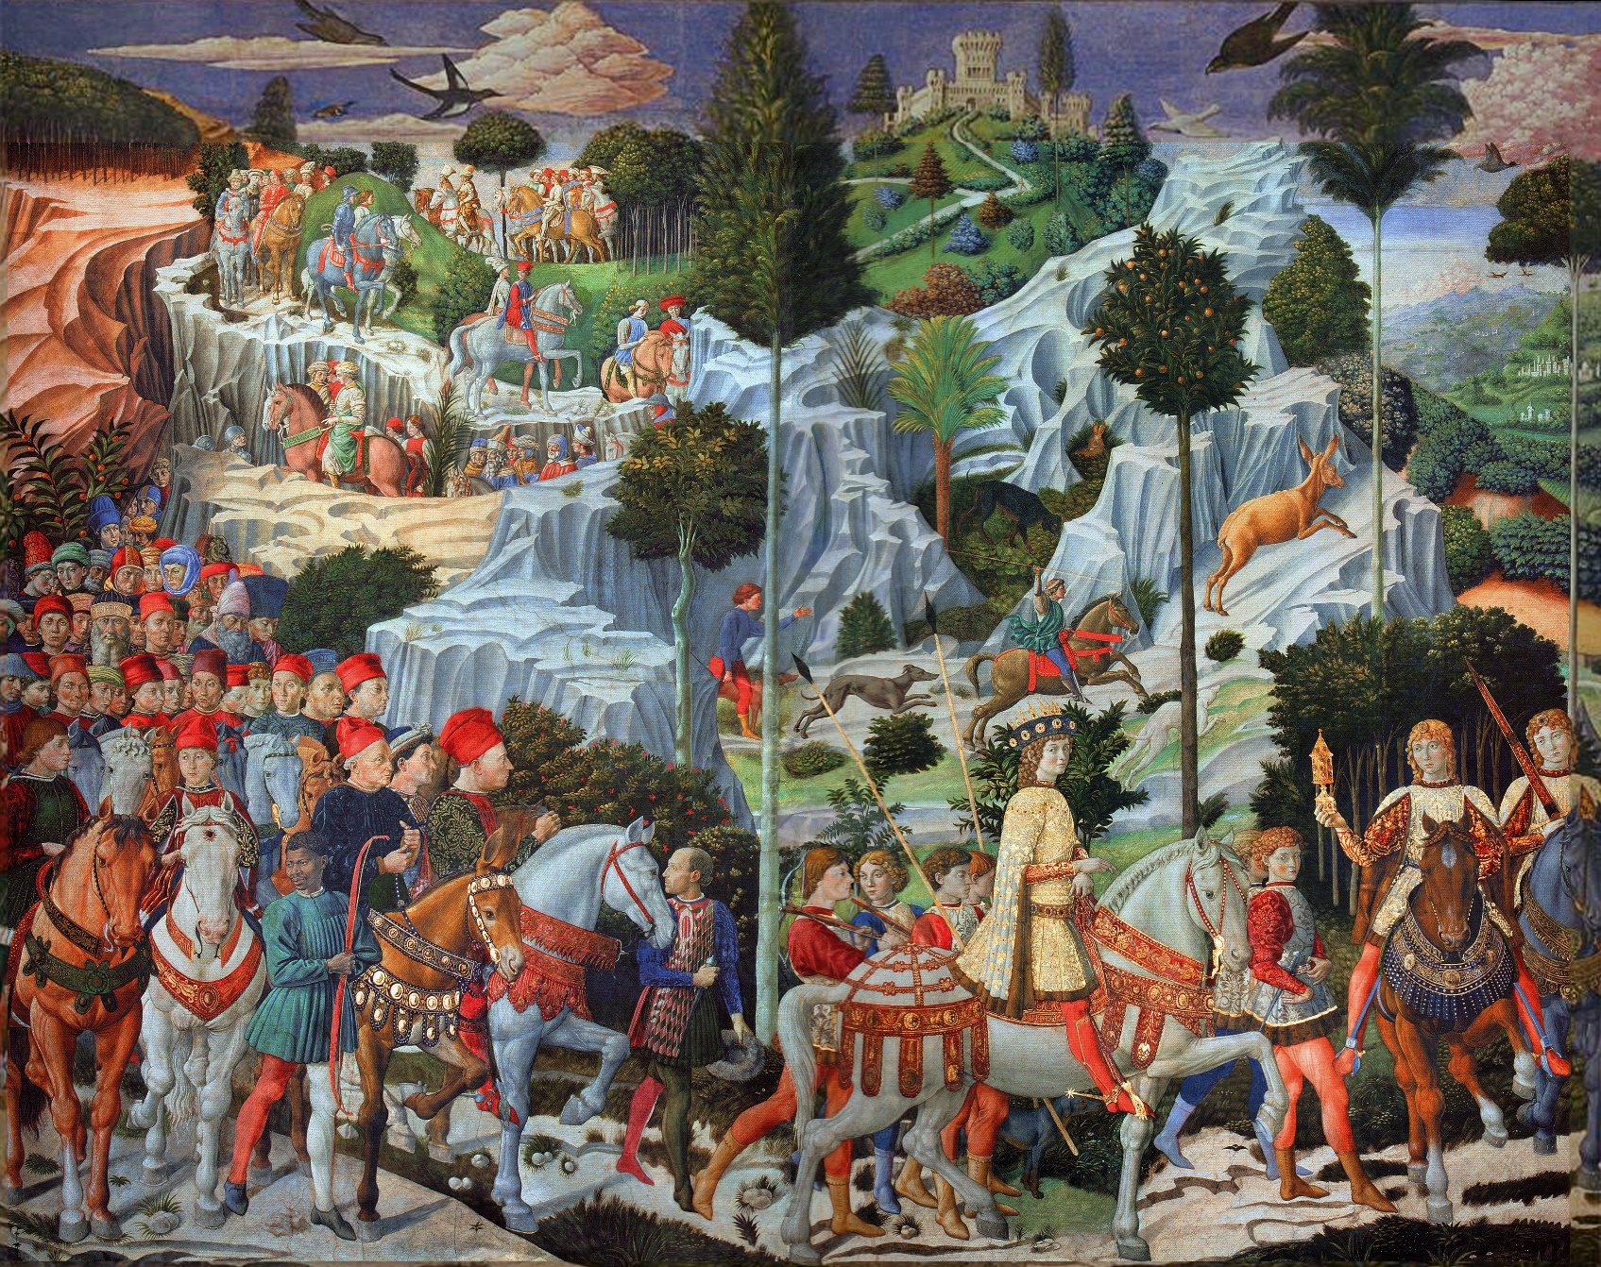
Later Attempts at Reconciliation with the Latins

Slide 8
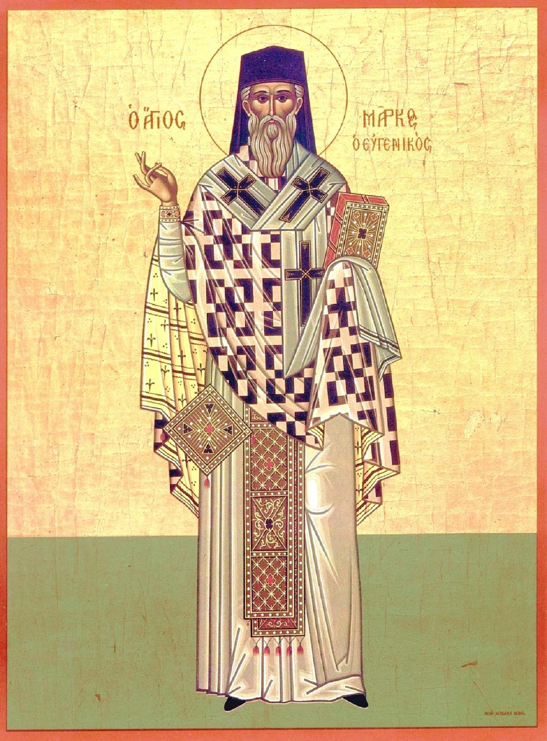
A Second Triumph of Orthodoxy

Slide 9
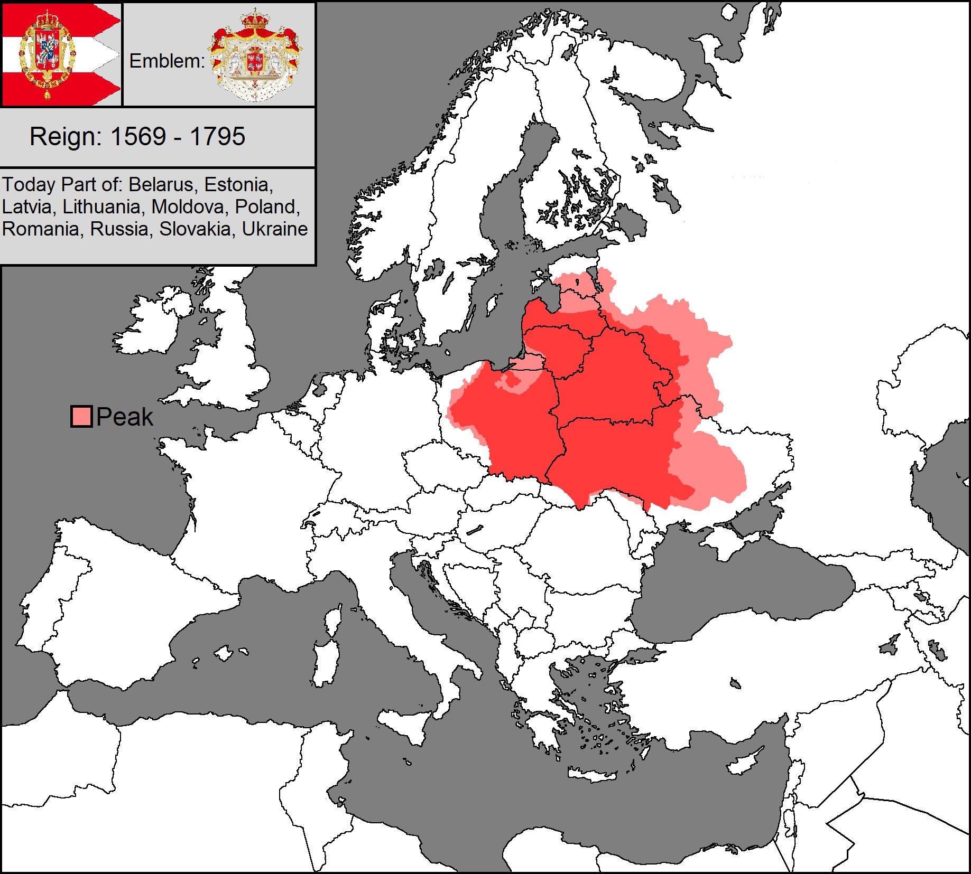

Slide 10
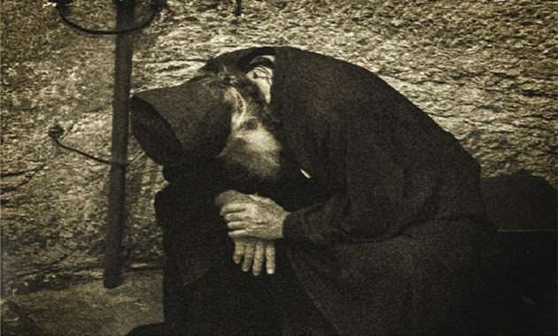
Mysticsm and the Orthodox Church
“A man who has progressed in natural love of men, when completely freed from self-love, receives the gift of healing.” - Maximus the Confessor

Slide 11
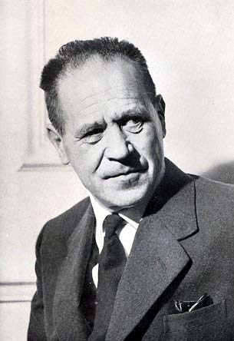
The Eastern Tradition of Mysticism
There is, therefore, no Christian mysticism without theology; but, above all, there is no theology without mysticism. - Vladimir Lossky

Slide 12
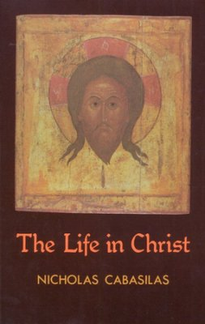
Works of St Nicholas Cabasilas
A Commentary on the Divine Liturgy
The Life in Christ
Against Usurers
Life of St. Theodora
On the Nonsense of Gregoras Only a fragment of the text is in Migne; also, the text is now attributed to Nilus Cabasilas
Illegal Acts of Officials Against Things Sacred Formerly attributed to Nilus Cabasilas and now believed to be the work of Nicholas Cabasilas
20
16
12
14
18
13
15
17
19
On the soul, the passions, and the purity of the mind in questions and
condescended to men’s weakness; and on temptations
homily 16
homily 38
homily 54
homily 70
homily 8
homily 26
homily 45
homily 64
Appendix A
[
On what helps a man to approach God in his heart,
An epistle of our Father among the Saints Isaac the
On the subject of prayer and the other things which
That the body that fears temptations becomes a
The concise sense of
On renouncing the world and refraining from
On the profit that comes to the soul that seeks after
Additional Homilies by Saint Isaac the Syrian,
On prayer, prostrations, tears, reading, silence,
]
the previous
chapter, with
210
profound theoria, that she might immerse herself therein away from
318
487
Syrian to his natural and spiritual brother, who, dwelling in the
and hymnody. Excellent admonitions that teach watchfulness and
From the Syriac Printed Text
familiarity with men
friend of sin
are necessarily required for constant recollection and are profitable
the significance of the things that were said; and on prayer
and what is the real cause that secretly brings help near him; and
185
252
again, what is the cause that leads a man to humility
404
rules for an ascetical way of life, that by them a man may acquire
in many ways, if a man read them with discretion and observe them
world and thirsting to see him, exhorted and entreated the saint by
the carnal thoughts that arise from the recollections of things
homily 17
On a rule for beginners and their state and the
447
letters to come to visit him in inhabited parts
355
for himself a comely rank
On the solitary life, and that we must not be timorous and afraid, but
Contents
homily 27
matters that pertain to them
Against those who say: If God is good, why has He
214
On silence
made these things?
257
homily 18
On the successive stages of the monastic life,
homily 65
An epistle of our Father among the Saints Isaac the
Protector
foreword
21
homily 28
briefly and distinctly noted; and how and in what way its virtues are
On the vision of the nature of incorporeal beings, in
Syrian, sent to his friend, wherein he expounds things respecting the
217
questions and answers
262
born from each other
mysteries of stillness, and how many monks, being ignorant of these
III
On
[
divine
]
overshadowing
546
rageous men • On the enemy’s fourth and obdurate warfare
things, are negligent in this wonderful activity, and that the major-
homily 19
homily 29
On the example and similitude furnished by a
That abstention from cares is profitable for hesy-
ity of them hold on to their cells by reason of the tradition current
homily 40
267
divine vision concerning the Lord’s Day and the Sabbath
chasts; and that going out and coming in is harmful; and concerning
On continuous fasting, and remaining collected in
homily 48
Containing counsels replete with profit, which he
among monks; and together with this, a brief collection of sayings
219
distraction
one place, and what are the consequences of this; and that by dis-
homily 11
spoke with love to those who listened to him humbly
On how the beauty of monastic life is preserved and
363
homily 30
On different suitable ways of wise guidance for the
useful for the practice of stillness
463
cerning knowledge I have learned the exact use of these things
329
on how it can be a means for God to be glorified
196
homily 56
On patience for the sake of the love of God, and in
homily 20
270
instruction of disciples
On the paths that bring a man nigh to God, which
415
what manner help is obtained through patience
VI
On hidden states, and the powers and operations therein
553
are revealed to him by the sweet works of night vigil; and that those
homily 31
Containing a most necessary and extremely benefi-
homily 74
222
who labor in this practice are fed with honey all the days of their life
On the means whereby a man can acquire a change
cial daily reminder for the man who has chosen to sit in his cell and
509
of his hidden thoughts with a change of his external discipline
homily 2
On thankfulness to God, in which there are also
homily 21
give heed to himself alone
A narration concerning saintly men and the all-
273
120
essential elementary lessons
Appendix B
557
The First Syriac Epistle of Saint Macarius of Egypt
226
holy words I heard from them, and on their wondrous way of life
homily 32
On the power and evil activity of sin, and on what
275
produces it and what causes it to cease
The trials of the friends of God, that is to say, the humble • The trials
homily 59
428
On love of the world
homily 22
On the different kinds of noetic powers of the mind
the ascetical homilies of saint isaac the syrian
the ascetical homilies of saint isaac the syrian
the ascetical homilies of saint isaac the syrian
the ascetical homilies of saint isaac the syrian
the ascetical homilies of saint isaac the syrian
contents
contents
contents
contents
236
employed in the working of revelations and spiritual visions
On involuntary evil thoughts that originate from the previous laxity
homily 34
282
On guarding the heart and on subtler divine vision
homily 35
284
On the signs and workings of the love of God
homily 52
On the three degrees of knowledge and the differ-
homily 4
On the love of God and renunciation and the rest
ence of their working and their ways of thinking; and on the faith
homily 14
Concerning hesychasts: on when they begin to un-
homily 36
On the modes of virtue
286
which is in God
141
homily 62
On how a man can know the measure in which he
homily 44
of the soul and the mystic riches concealed in it; and on how much
An epistle of our Father among the Saints Isaac the
derstand what place they have attained with their labors in the
homily 76
stands by the thoughts that are stirred in him
An answer that Saint Isaac made to a brother who
438
homily 37
Syrian written to a certain brother possessed of the love of stillness,
the knowledge of this world in its ways and means is opposed to the
A discourse on various subjects in questions and an-
boundless sea that is the life of stillness; and on when they can have
asked him, ‘Why is it that, although our Lord defined mercy as
on how the devil contrives to make those who constantly endeavor to
swers, on the trustworthy way of life and every kind of virtue. This
390
simplicity of faith
a little hope that their toils have begun to yield them fruit
201
On pure prayer
likeness to the majesty of the Heavenly Father, solitaries honor
practise stillness to desist from their constant stillness by means of
discourse will be especially useful for those who have stripped off the
stillness above mercy?’ And a defense concerning this; and that it is
world, those who dwell in the desert, those who are recluses, and
the love of a relative or honored men, and on how it behooves the
not right to neglect the afflicted and the sick when they are near
528
fection • A recapitulation of the three degrees of knowledge
hesychast to disdain all things for the sake of the knowledge of God
those who through voluntary mortification look forward to the crown
289
which is to be found in stillness, even as it has been shown in the case
of righteousness
homily 7
On the kinds of hope in God; and for whom it is
of our Fathers of old
350
right to put his hope in God, and who it is that entertains such hope
181
foolishly and imprudently
11
Copyright © 2011, Holy Transfiguration Monastery, Brookline, MA
All Rights Reserved.
I
[
]
On the different kinds of revelations and
divine
workings
homily 39
On the different methods of the devil’s warfare
homily 71
On the difference of the virtues, on the end of the
540
given to the saints in images and likenesses
homily 9
On sins voluntary and involuntary, and on those
against those who journey on the narrow way that transcends the
entire course, and on the greatness of love for mankind which in a
must make our heart steadfast through trust in God, and have courage
homily 46
189
which are committed because of some accidental circumstance
Containing profitable subjects replete with the wis-
320
world
II
On the gloomy darkness that befalls those who pursue the life
with unhesitating faith, since we possess God as our Guardian and
spiritual manner perfects all the saints, and firmly plants the divine
357
dom of the Spirit
minion of the mind; and to what extent this dominion is empowered
world
ment of a definite quantity of prayers, but rather with freedom and
encomium
translator’s introduction
homily 1
homily 3
homily 5
homily 6
homily 23
homily 24
homily 25
homily 41
homily 42
homily 43
homily 55
homily 57
homily 58
homily 60
homily 61
homily 63
homily 72
homily 73
homily 75
homily 77
answers • On the senses, and on temptations also • On our Master’s
tender compassion, whereby from the height of His majesty He has
On an aged elder • On another elder • On the question of a certain
brother • On the reproach of a certain brother
On that which during prayer occurs within stillness
On the first method • On the second method of the devil’s warfare
On the third method of the enemy’s warfare against strong and cou-
of the enemies of God, that is to say, the proud • On patience • On
faint-heartedness
On the purification of the body, the soul, and the mind
to repentance, and that they were said with a view to men’s weak-
those who are making their way on the path of stillness, which has
been laid out by God; for sometimes melancholy and suffocation of
to Him Who orders our paths aright! Amen
in danger of falling
the measures pertaining to faith
cur in the soul at all times, and her training in matters of the right
diverse concepts, and on what use each one of them has
stillness
how one ought to know clearly that not only certain lesser, weak,
and untrained men are tempted, but also those are tempted who have
homily 10
homily 12
homily 13
homily 15
homily 33
homily 47
homily 49
homily 50
homily 51
homily 53
homily 66
homily 67
homily 68
homily 69
Appendix C
Appendix D
Index of Subjects
Index of Scriptural Passages
On the passions
On fasting and vigil • On the difference in tears
On the second activity that works upon man
of negligence
On the first degree of knowledge • On the second degree of knowl-
A selection of short sections
The First Syriac Epistle of Saint Macarius of Alexandria, On the
Christian Discipline
God’s
426
421
468
473
281
Brief subjects
On why men who are unspiritual in their knowl-
On the words of the divine writings which urge men
That the servant of God who has stripped himself
[
]
-
499
346
491
507
337
431
113
45
200
568
544
578
575
edge investigate spiritual things in accord with the grossness of their
edge
flesh; and on how the mind can be raised above the grossness of the
tasies at the time of entreaty
within his cell
truth’s sake; and on the levels and disciplines through which the
sagacious man makes his way
days in the life of knowledge
to have manifest signs wrought by our hands or unto us
out upon the race of the sons of men
vance; and that we must not make the aim of our labors the fulfill-
ian, Inadequate for the Sublimity of its Subject, but Written With
Much Love,
Life and Writings of Saint Isaac the Syrian
of the wisdom of God and of His creatures, if she becomes still to the
world and the cares of life; for then she can come to know her nature
sweet are the temptations that come to pass and are endured for the
the force of each, and what is the difference of each
served, and how sleep and coldness steal into the mind and quench
the soul’s holy fervor and deaden the Godward desire that yearns for
are tested by prayer
come upon those who love Him
likeness in them through God’s abundant love, which He has poured
discernment we should be like children of God with their Father, la-
vigil is more venerable than all other disciplines; and on what things
and what treasures she has hidden within herself
to initiate its own movements in the different forms of prayer; and
things spiritual and heavenly
boring with the eagerness proper to love; and on how the work of
are sought by those who choose this work; and on how men should
on when and by what means the mind can remain without phan-
perform night vigil; and on the gifts that these men are granted from
very lofty is its rank
God, and the conflicts and battles waged against them by the ruler
of this world
susceptible to accidents; and on ascetical activities
flesh, and what is the cause that a man is not liberated from it; and
what the natural limit of prayer is, and to what extent you are em-
is no longer prayer, although this activity is called prayer
all things that disquiet the mind
powered to pray therein; and that when prayer exceeds this limit, it
raised above the passions in so far as this is permitted by God while
perfection in their manner of thought, and have in part drawn near
to the purity that is conjoined with mortification, and have been
been accounted worthy of dispassion for a time, who have achieved
ness, lest they perish from the living God, but that one must not
employ them as an excuse for sinning
of knowledge
of the things of the world, and is come forth in quest of Him, must
never, because he has not attained to a sure apprehension of the
soul occur, sometimes sudden joy and unaccustomed fervor. Glory be
by God’s providence for the soul’s advancement in things spiritual
and of the left
fear of God, and on the help that comes of clemency; and on other
subjects
of life from the changing states of our mind, and that we should not
of knowledge in stillness
world
truth, cease from his quest for fear of this, and grow cold in that ar-
dor which is born of love for things divine and of searching out their
childishly rely on the great diversity of our labors, but as wise men
we should recognize the degree of our soul from the secret renewal
which we perceive day by day; and on the subtle stage of discern-
men are in this world, under the yoke of life conjoined to the pas-
mysteries; and on how the mind is confounded by the memory of the
ment
passions
sionate flesh: they have a contest, and are vexed with passions
negligent men, and on how, by drawing near to them, heedlessness
because of the flesh, and in
and laxity rule over a man and he is filled with every passion. And
defiled by licentious thoughts
on guarding oneself from proximity to youths, lest the mind be
ment on certain occasions because of the danger of pride
IV
V
VII
edge • On the third degree of knowledge, which is the degree of per-
On the workings of grace
]
by Photios Kontoglou
On how it is right for a man’s life to be set apart
On renunciation and the monastic life
On keeping oneself remote from the world and from
That without toil the soul enters into understanding
That to our profit God has permitted the soul to be
An Offering of Praise to Saint Abba Isaac the Syr
On the subject of a discourse spoken by true knowl-
On how the hidden wakefulness in the soul is pre-
An explanation of the modes of discipline: what is
On the motions of the body
On the many different kinds of prayer, and the do-
On faith and humility
On the many changes that cleave to the mind and
On the kinds of different temptations; and on how
That without necessity we should not desire or ask
On night vigil and the various ways of its obser-
On those who live near to God and pass all their
On the things that are bestowed upon a brother
On the reasons why God permits temptations to
On how much honor humility obtains, and how
On the benefit to be had from fleeing from the
On the varying states of light and darkness that oc-
On the harm of foolish zeal that has the guise of the
Glossary
That in certain conflicts, labor is better than being
Table of Homily Equivalences
A study and elucidation with examples concerning
Short sections on other differences in the concepts
That we can understand the degree of our manner
On how great are the measures of knowledge and
On the alteration and change that takes place in
On the angelic movement that is awakened in us
On guarding and keeping oneself from lax and
On true knowledge, and on temptations, and on
On how the discerning monk ought to dwell in
A Historical Account of the
51
127
155
169
193
198
203
238
246
248
340
360
373
376
378
402
412
436
444
476
mercy they even suffer abandon-
481
515
534
[
from the
547
550
554
605

Slide 13
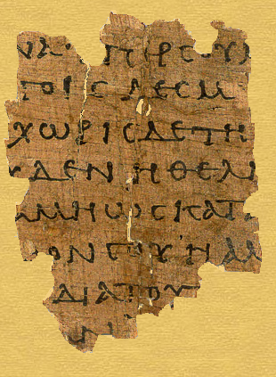
Discussion
Selected Quotes
From
St Nicholas Cabasilas
Commentary on the Divine Liturgy: The Anaphora

