Slide 1
Know Your Faith IV: The Fathers of the Church
Lesson 14
The Syriac Fathers:
Introduction and
St Ephraim the the Syrian

Slide 2
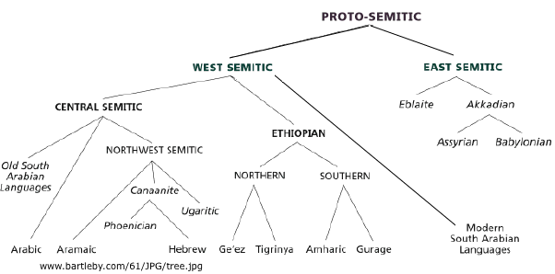
Syriac in Relation to Its Neighboring Languages

Slide 3
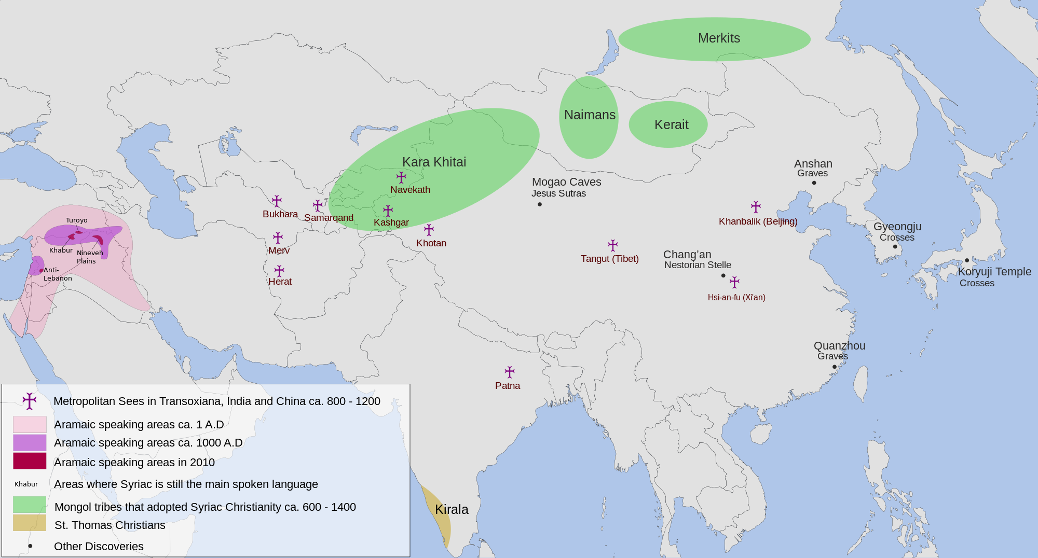
Syriac in the Near and Far East

Slide 4
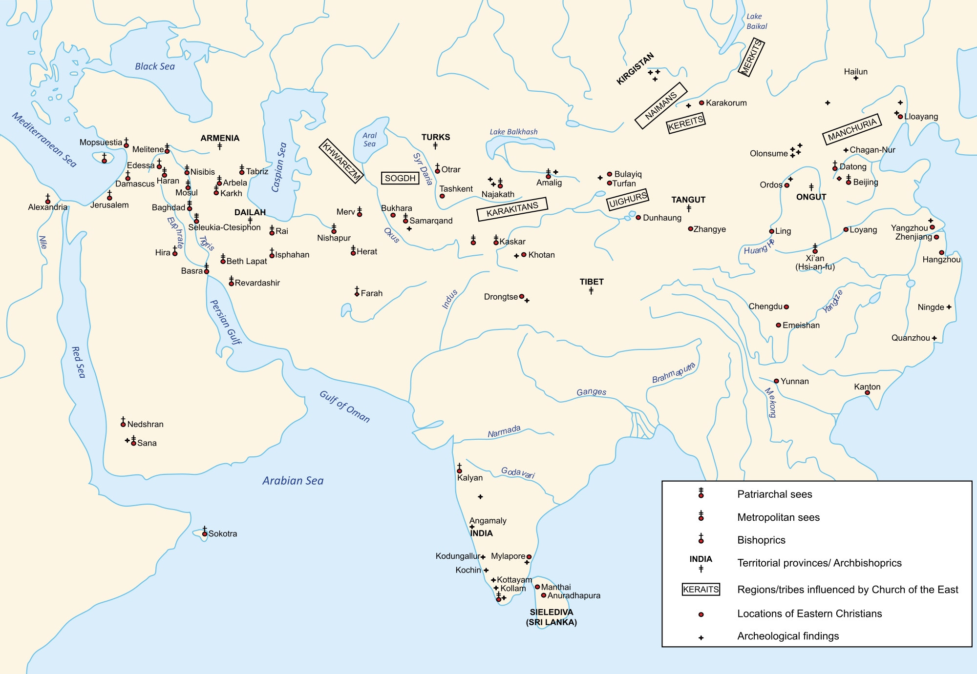

Slide 5
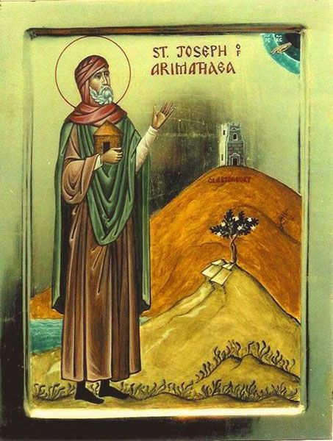
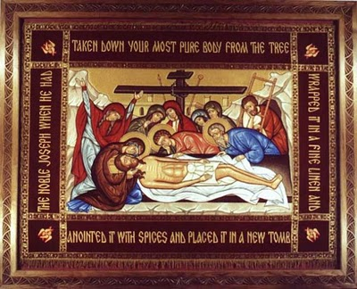
St Joseph of Aramathea

Slide 6
The Churches of the Syriac East
Modern Non-Chalcedonians
Oriental Orthodox Churches
The Coptic Orthodox Church of Alexandria
The Syriac Orthodox Church of Antioch (sometimes called 'Jacobite')
Malankara Syriac Orthodox Church, a branch of the Oriental Orthodox Patriarch of Antioch
The Church of Armenia (sometimes called the Armenian Apostolic Church)
The Malankara Orthodox Syrian Church (sometimes called the Indian Orthodox Church)
The Ethiopian Orthodox Church
The Eritrean Orthodox Church

Slide 7
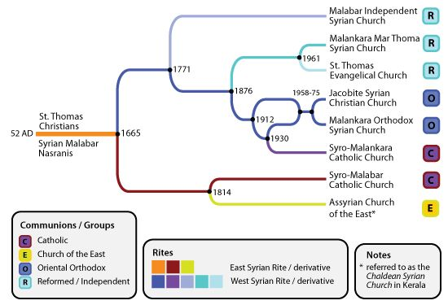

Slide 8
Fathers of the Syriac Church
Anicetus of Rome
Gregory Bar-Hebræus
Basil of Beth Man'em
Cyriacus of Antioch
Elijah of Antioch
Ephraim of Antioch
Ephrem the Syrian
Eustathius of Kunnamkulam
Frumentius of Axum
George I of Antioch
Gregory III of Rome
Isaac of Syria
Jacob Baradaeus
Jacob of Edessa
Jacob of Nisibis
Jacob of Serugh
John of Mardin
John of Sedre
John the Cantor
Julius of Goa
Mar Awgin
Marutha of Tikrit
Moses of Beth Romon
Nine Saints Who Missionized Ethiopia
Palladius the Hermit
Paul of Edessa
Pelagia of Antioch
Severus Sabukht
Simon of Harran
Theodora (wife of Justinian)
Thomas of Mabugh

Slide 9
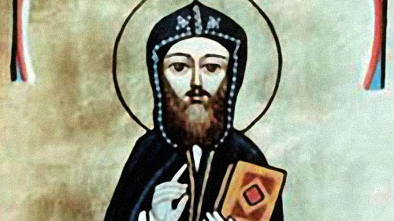
Other Notable Figures of the Syriac East
Cyrillonas
Rabbula
Philoxenus of Mabbug
Severus of Antioch

Slide 10
Relationship With Oriental Orthodox Churches

Slide 11
The Trisagion Hymn
Holy God! Holy Mighty! Holy Immortal! Have mercy on us!
Holy God! Holy Mighty! Holy Immortal! Have mercy on us!
Holy God! Holy Mighty! Holy Immortal! Have mercy on us!
Glory to the Father, and to the Son, and to the Holy Spirit, now and ever, and unto ages of ages. Amen.
Holy Immortal! Have mercy on us!
Holy God! Holy Mighty! Holy Immortal! Have mercy on us!

Slide 12
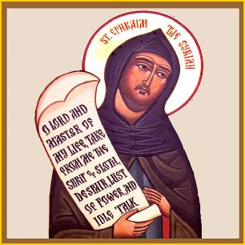
St Ephraim the Syrian
Born c 306 in Nisbis
Died 373 or 379 in Edessa
Deacon of the Church
Hymnographer
The Lyre of the Holy Spirit

Slide 13
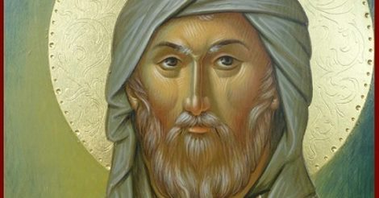
Points of Doctrine
Trinity and Christology
On the Virgin Mary
The Nature of the Eucharist

Slide 15
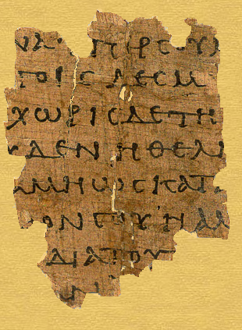
Discussion
Selection from
On Prayer

