Slide 1
Know Your Faith IV: The Fathers of the Church
Lesson 5: The Blessed Augustine

Slide 2
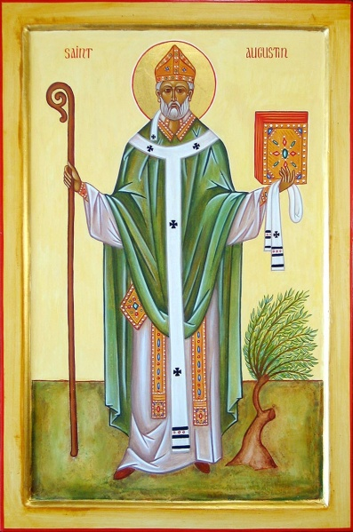
St Augustine of Hippo
Aurelius Augustinus
13 November 354 – 28 August 430
Ordained priest in 391
Consecrated as Bishop of Hippo in 395
Feast Day June 15
Patron Saint of Brewers and Bridgeport, Connecticut

Slide 3
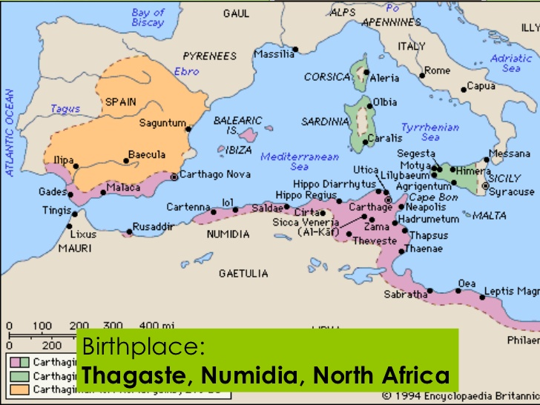

Slide 4
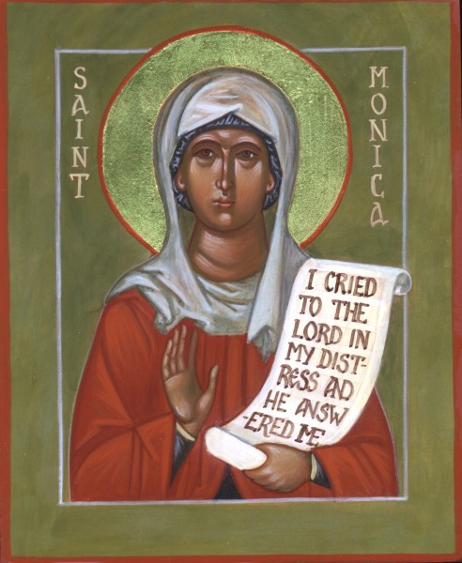
322-387
Christian
Married to a pagan
Commemorated on May 4

Slide 5
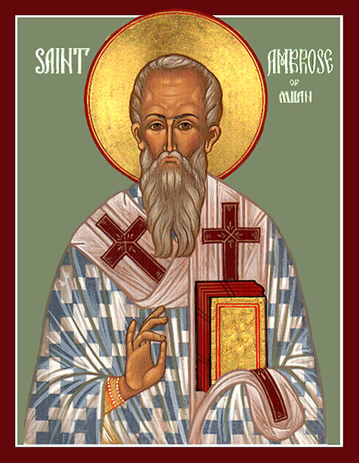

Slide 6
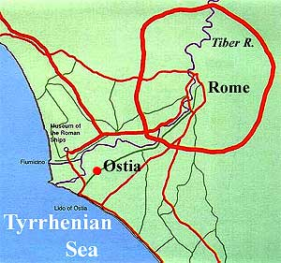
I sent up these sorrowful cries,—“How long, how long? Tomorrow, and tomorrow? Why not now? Why is there not this hour an end to my uncleanness?”
I was saying these things and weeping in the most bitter contrition of my heart, when, lo, I heard the voice as of a boy or girl, I know not which, coming from a neighbouring house, chanting, and oft repeating, “Take up and read; take up and read.” Immediately my countenance was changed, and I began most earnestly to consider whether it was usual for children in any kind of game to sing such words; nor could I remember ever to have heard the like. So, restraining the torrent of my tears, I rose up, interpreting it no other way than as a command to me from Heaven to open the book, and to read the first chapter I should light upon.
I returned to the place where Alypius was sitting; for there had I put down the volume of the apostles, when I rose thence. I grasped, opened, and in silence read that paragraph on which my eyes first fell,—“Not in rioting and drunkenness, not in chambering and wantonness, not in strife and envying; but put ye on the Lord Jesus Christ, and make not provision for the flesh, to fulfil the lusts thereof.” No further would I read, nor did I need; for instantly, as the sentence ended,—by a light, as it were, of security infused into my heart,—all the gloom of doubt vanished away.

Slide 8
Enchiridion
You are anxious, you say, that I should write a sort of handbook for you, which you might always keep beside you, containing answers to the questions you put, viz.: what ought to be man's chief end in life; what he ought, in view of the various heresies, chiefly to avoid; to what extent religion is supported by reason; what there is in reason that lends no support to faith, when faith stands alone; what is the starting-point, what the goal, of religion; what is the sum of the whole body of doctrine; what is the sure and proper foundation of the catholic faith. Now, undoubtedly, you will know the answers to all these questions, if you know thoroughly the proper objects of faith, hope, and love. For these must be the chief, nay, the exclusive objects of pursuit in religion. He who speaks against these is either a total stranger to the name of Christ, or is a heretic.
His Works - The list from NPNF
Volume I - Prolegomena: St. Augustine's Life and Work, Confessions, Letters
Volume II - The City of God, On Christian Doctrine
Volume III - On the Holy Trinity, Doctrinal Treatises, Moral Treatises
Volume IV - The Anti-Manichaean Writings, The Anti-Donatist Writings
Volume V - Anti-Pelagian Writings
Volume VI - Sermon on the Mount, Harmony of the Gospels, Homilies on the Gospels
Volume VII - Homilies on the Gospel of John, Homilies on the First Epistle of John, Soliloquies
Volume VIII - Expositions on the Psalms

Slide 9
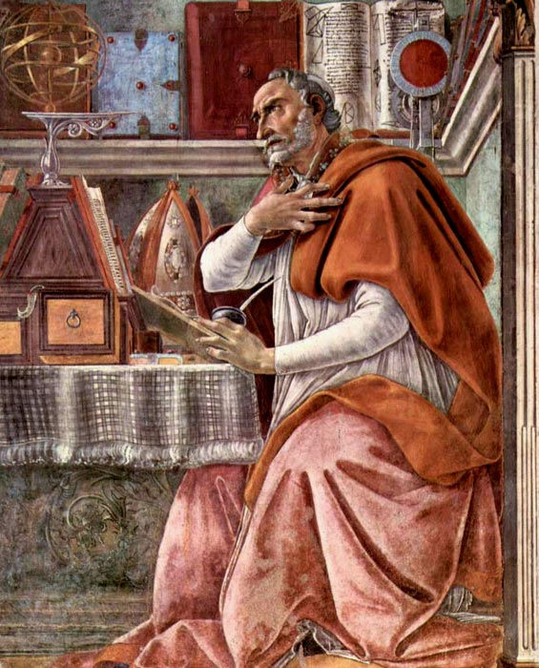
Created to Rest in God
I.1. Great art Thou, O Lord, and greatly to be praised; great is Thy power, and of Thy wisdom there is no end.¹²¹ And man, being a part of Thy creation, desires to praise Thee, man, who bears about with him his mortality, the witness of his sin, even the witness that Thou “resistest the proud,”¹²²—yet man, this part of Thy creation, desires to praise Thee.¹²³ Thou movest us to delight in praising Thee; for Thou hast formed us for Thyself, and our hearts are restless till they find rest in Thee.¹²⁴ Lord, teach me to know and understand which of these should be first, to call on Thee, or to praise Thee; and likewise to know Thee, or to call upon Thee. But who is there that calls upon Thee without knowing Thee? For he that knows Thee not may call upon Thee as other than Thou art. Or perhaps we call on Thee that we may know Thee.

Slide 10
Theological Opponents
The Heresies
Pelagianism is the belief that original sin did not taint human nature and that mortal will is still capable of choosing good or evil without special Divine aid.
Donatism held that the church must be a church of "saints," not "sinners," and that sacraments, such as baptism, administered by traditores were invalid.
Manichaeism taught an elaborate dualistic cosmology describing the struggle between a good, spiritual world of light, and an evil, material world of darkness. Through an ongoing process which takes place in human history, light is gradually removed from the world of matter and returned to the world of light whence it came. Its beliefs were based on local Mesopotamian gnostic and religious movements.

Slide 11
Ruins of the Cathedral of Hippo

Slide 12
Orthodox Assessment
Original Sin
Free Will
Predestination and Grace
Purgatory
Statement of the 5th Ecumenical Council
We further declare that we hold fast to the decrees of the four Councils, and in every way follow the holy Fathers, Athanasius, Hilary, Basil, Gregory the Theologian, Gregory of Nyssa, Ambrose, Theophilus, John (Chrysostom) of Constantinople, Cyril, Augustine, Proclus, Leo and their writings on the true faith.

