Slide 1
Know Your Faith IV: The Fathers of the Church
Lesson 7: St Athanasius the Great,
Bishop of Alexandria

Slide 2
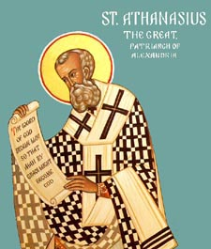
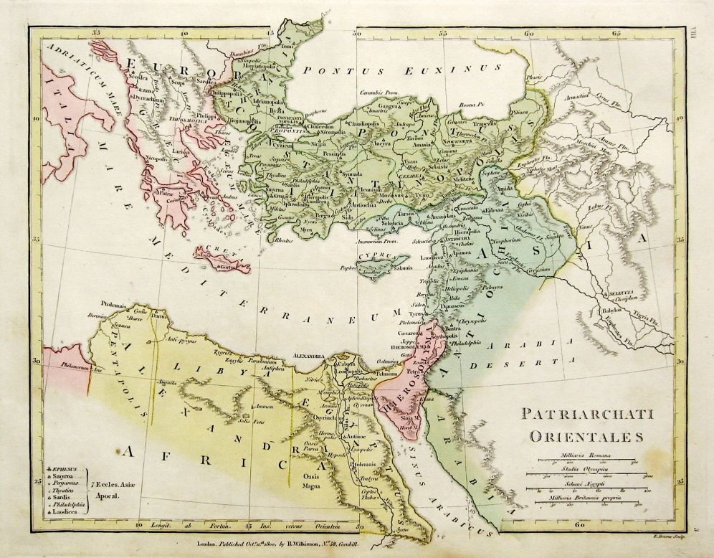
St Athanasius the Great, Bishop of Alexandria
298-373
Present at Nicea
Prolific Writer
Defender of the Faith
Endured Many Unjust Punishment

Slide 3
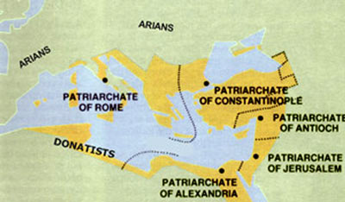

Slide 4
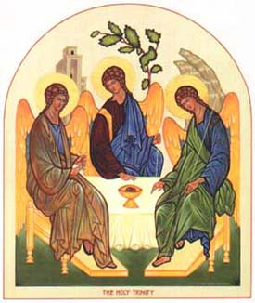
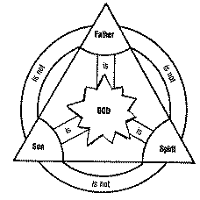
Arianism: Denial of the true divinity of Jesus Christ taking various specific forms, but all agreed that Jesus Christ was created by the Father, that he had a beginning in time, and that the title "Son of God" was a courtesy one.[10]
Orthodox Position: Homoousius, Christ is of one substance as the Father

Slide 5
Diptychs of the Orthodox Patriarchates
To His All Holiness, BARTHOLOMEW, Archbishop of Constantinople, New Rome and Ecumenical Patriarch: Many Years!
To His Beatitude, THEODOROS, Pope and Patriarch of Alexandria and All Africa: Many Years!
To His Beatitude, JOHN, Patriarch of Antioch and All the East: Many Years!
To His Beatitude, THEOPHILUS, Patriarch of the Holy City of Jerusalem and All Palestine: Many Years!
To His Holiness, KIRILL, Patriarch of Moscow and All Russia: Many Years!
To His Holiness, ILIA, Catholicos and Patriarch of All Georgia: Many Years!
To His Holiness, IRINEJ, Patriarch of Serbia: Many Years!
To His Beatitude, DANIEL, Patriarch of Romania: Many Years!
To His Holiness, NEOFIT, Patriarch of Bulgaria: Many Years!
To His Beatitude, CHRYSOSTOMOS, Archbishop of New Justiniana and All Cyprus: Many Years!
To His Beatitude, IERONYMOS, Archbishop of Athens and All Greece: Many Years!
To His Beatitude, ANASTASIOS, Archbishop of Tirana and All Albania: Many Years!
To His Beatitude, SAWA, Metropolitan of Warsaw and All Poland: Many Years!
To His Beatitude, RASTISLAV, Metropolitan of the Czech Lands and Slovakia: Many Years!
To His Beatitude, TIKHON, Archbishop of Washington, Metropolitan of All America and Canada: Many Years!
To all Orthodox Metropolitans, Archbishops, and Bishops: Many Years!
To all Orthodox Christians: Many Years!

Slide 6
Times and Places of Exile
First Exile from July 11, 335 to November 22, 337, in Trier, Germany
Second from April 16, 339 to October 21, 346, in Rome
Third Exile from February 356 to February 21, 362, in the Egyptian Desert
Fourth Exile from October 4, 362 to February 14, 364, in the Egyptian Desert

Slide 7
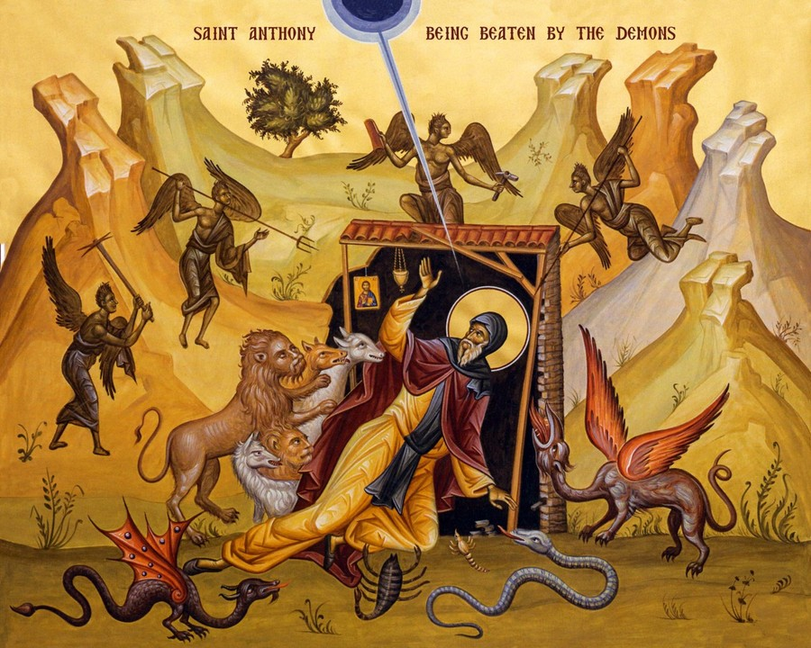
Works of St Athanasius
On the Incarnation: Constitutes the first classic work of developed Orthodox theology. In the first part, Athanasius attacks several pagan practices and beliefs. The second part presents teachings on the redemption, as well as the belief that the Son of God, the eternal Word through whom God created the world, entered that world in human form to lead men back into the harmony from which they had earlier fallen away.
Life of St Anthony: it played an important role in the spreading of the ascetic ideal in Eastern and Western Christianity. Depicting Anthony as a holy man who through his existence in a primordial landscape has an absolute connection to the divine truth
Defense of His Flight: The Apology is on the duty of Christians under persecution. He felt called upon to defend his conduct in retreating `until the tyranny be overpast.' Rashness must be avoided, and its presumption in forestalling the time appointed by Providence for our death. But neither must that time be evaded. When our end must come, we must face it quietly.

Slide 8
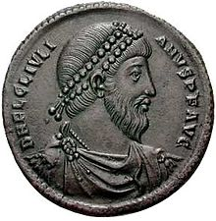
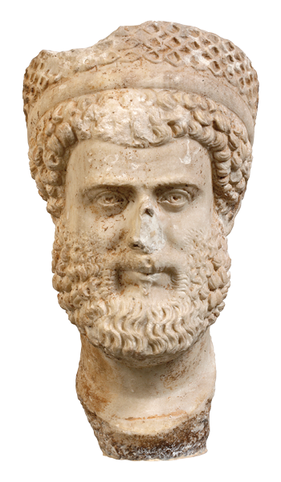
Julian the Apostate

Slide 9
39th Paschal Letter of St Athanasius
5. Again it is not tedious to speak of the [books] of the New Testament. These are, the four Gospels, according to Matthew, Mark, Luke, and John. Afterwards, the Acts of the Apostles and Epistles (called Catholic), seven, viz. of James, one; of Peter, two; of John, three; after these, one of Jude. In addition, there are fourteen Epistles of Paul, written in this order. The first, to the Romans; then two to the Corinthians; after these, to the Galatians; next, to the Ephesians; then to the Philippians; then to the Colossians; after these, two to the Thessalonians, and that to the Hebrews; and again, two to Timothy; one to Titus; and lastly, that to Philemon. And besides, the Revelation of John.
6. These are fountains of salvation, that they who thirst may be satisfied with the living words they contain. In these alone is proclaimed the doctrine of godliness. Let no man add to these, neither let him take ought from these. For concerning these the Lord put to shame the Sadducees, and said, ‘Ye do err, not knowing the Scriptures.’ And He reproved the Jews, saying, ‘Search the Scriptures, for these are they that testify of Me.’

