Slide 1
Know Your Faith IV: The Fathers of the Church
Lesson 12
The Desert Fathers
St Anthony the Great

Slide 2
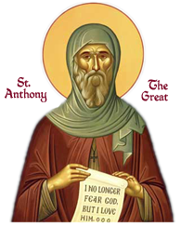
St Anthony the Great
251, Coma, Egypt
to
356, The Desert
Known as:
The Father of Monasticism
A Great Hermit

Slide 3
The Desert Fathers
Monasticism is important to the Christian Life
For the Iife of the World
Following the example of John the Baptist, among others
Arabian Desert, Egyptian Desert
The Desert of the Heart
Seeking salvation
The Desert speaks to the Christian

Slide 4
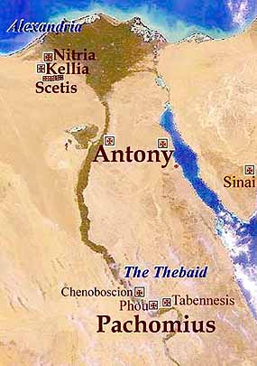
The Egyptian Desert:
A Training Ground for holiness

Slide 5
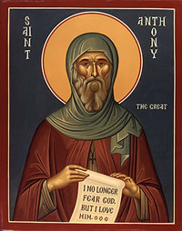
Life of St Anthony
251: Born in Coma Thebaid, Egypt
c. 271: Parents Die
Leaves for the monastic life
Settled near Coma
c. 286: Retreats further into the desert
c. 299: Retreats even further
c. 299-319: Near Pispir, Egypt
311: Maximian's Persecution and trip to Alexandria
338: Second trip to Alexandria
356: Reposes at his monastery

Slide 6
The Calling of the Desert
"If you would be perfect, go, sell what you possess and give it to the poor, and you will have treasure in heaven; and come follow Me."
Gospel According to Matthew, 19.21

Slide 7
The Ascetic Struggles

Slide 8
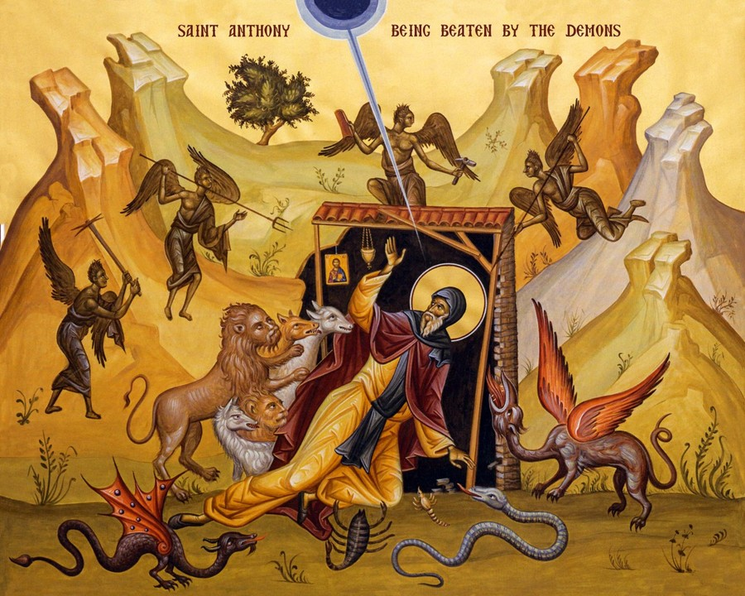

Slide 9
Writings of St Anthony
Sermons on the virtues, primarily monastic (probably spurious).
Seven Letters to various Egyptian monasteries concerning moral perfection, and the monastic life as a spiritual struggle.
A Rule for monastics (not regarded as an authentic work of St Anthony).
The Life of St Anthony by St Athanasius the Great

Slide 10
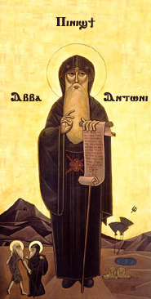
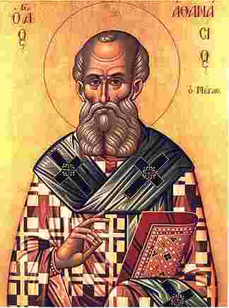
"A time is coming when men will go mad, and when they see someone who is not mad, they will attack him saying, 'You are mad, you are not like us'."

Slide 11
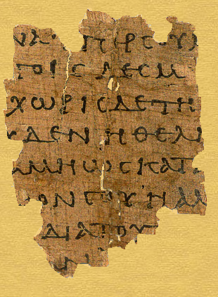
Discussion
St Gregory the Theologian’s
Theological Oration #5
On the Holy Spirit

